Slide 1
Operating System (22CS005) Class
On
Introduction to Operating systems
Department of Computer Science and Engineering,
Chitkara University, Punjab
Dr. Prabhjot Chahal Operating System - 22CS005

Slide 2
Deadlock
Every process needs some resources to complete its execution. However, the resource is granted in a sequential order.
The process requests for some resource.
OS grant the resource if it is available otherwise let the process waits.
The process uses it and release on the completion.
A Deadlock is a situation where each of the computer process waits for a resource which is being assigned to some another process. In this situation, none of the process gets executed since the resource it needs, is held by some other process which is also waiting for some other resource to be released.

Slide 3
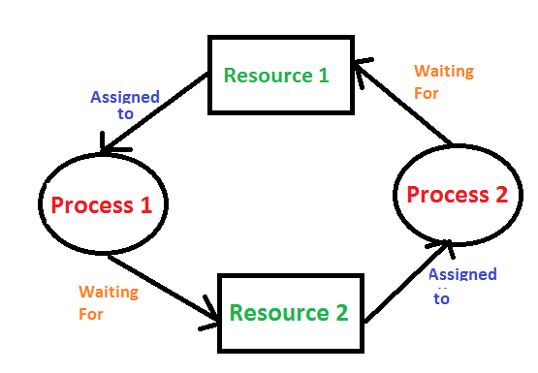
Example

Slide 4
Conti…
Deadlock Detection :
1. If resources have a single instance – In this case for Deadlock detection, we can run an algorithm to check for the cycle in the Resource Allocation Graph. The presence of a cycle in the graph is a sufficient condition for deadlock.
2. In the above diagram, resource 1 and resource 2 have single instances. There is a cycle R1 → P1 → R2 → P2. So, Deadlock is Confirmed.
3. If there are multiple instances of resources – Detection of the cycle is necessary but not sufficient condition for deadlock detection, in this case, the system may or may not be in deadlock varies according to different situations.

Slide 5
4 Conditions deadlocks
Necessary conditions for Deadlocks
Mutual Exclusion
A resource can only be shared in mutually exclusive manner. It implies, if two process cannot use the same resource at the same time.

Slide 6
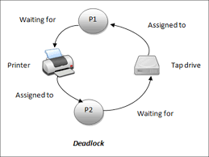
Mutual Exclusion

Slide 7
Hold and Wait
Hold and Wait
A process waits for some resources while holding another resource at the same time.

Slide 8
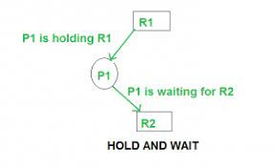
Hold and Wait

Slide 9
Cont…
No preemption
The process which once scheduled will be executed till the completion. No other process can be scheduled by the scheduler meanwhile.
Circular Wait
All the processes must be waiting for the resources in a cyclic manner so that the last process is waiting for the resource which is being held by the first process.

Slide 10
Recovery from Deadlock in Operating System
Deadlock Recovery : A traditional operating system such as Windows doesn’t deal with deadlock recovery as it is a time and space-consuming process. Real-time operating systems use Deadlock recovery.
Killing the process – Killing all the processes involved in the deadlock. Killing process one by one. After killing each process check for deadlock again keep repeating the process till the system recovers from deadlock. Killing all the processes one by one helps a system to break circular wait condition.

Slide 11
Cont..
Resource Preemption – Resources are preempted from the processes involved in the deadlock, preempted resources are allocated to other processes so that there is a possibility of recovering the system from deadlock. In this case, the system goes into starvation.

Slide 12
Cont..
1. Process Termination: To eliminate the deadlock, we can simply kill one or more processes. For this, we use two methods:
(a). Abort all the Deadlocked Processes: Aborting all the processes will certainly break the deadlock, but with a great expense. The deadlocked processes may have computed for a long time and the result of those partial computations must be discarded and there is a probability to recalculate them later.
(b). Abort one process at a time until deadlock is eliminated: Abort one deadlocked process at a time, until deadlock cycle is eliminated from the system. Due to this method, there may be considerable overhead, because after aborting each process, we have to run deadlock detection algorithm to check whether any processes are still deadlocked.

Slide 13
Cont..
2. Resource Preemption: To eliminate deadlocks using resource preemption, we preempt some resources from processes and give those resources to other processes. This method will raise three issues –
(a). Selecting a victim: We must determine which resources and which processes are to be preempted and also the order to minimize the cost.

Slide 14
Cont..
(b). Rollback: We must determine what should be done with the process from which resources are preempted. One simple idea is total rollback. That means abort the process and restart it.
(c). Starvation: In a system, it may happen that same process is always picked as a victim. As a result, that process will never complete its designated task. This situation is called Starvation and must be avoided. One solution is that a process must be picked as a victim only a finite number of times.

Slide 15
Deadlock Prevention
1. Mutual Exclusion
Mutual section from the resource point of view is the fact that a resource can never be used by more than one process simultaneously which is fair enough but that is the main reason behind the deadlock. If a resource could have been used by more than one process at the same time then the process would have never been waiting for any resource.

Slide 16
Cont..
2. Hold and Wait
Hold and wait condition lies when a process holds a resource and waiting for some other resource to complete its task. Deadlock occurs because there can be more than one process which are holding one resource and waiting for other in the cyclic order.
However, we have to find out some mechanism by which a process either doesn't hold any resource or doesn't wait. That means, a process must be assigned all the necessary resources before the execution starts. A process must not wait for any resource once the execution has been started.
!(Hold and wait) = !hold or !wait (negation of hold and wait is, either you don't hold or you don't wait)

Slide 17
Cont..
3. No Preemption
Deadlock arises due to the fact that a process can't be stopped once it starts. However, if we take the resource away from the process which is causing deadlock then we can prevent deadlock.
This is not a good approach at all since if we take a resource away which is being used by the process then all the work which it has done till now can become inconsistent.
Consider a printer is being used by any process. If we take the printer away from that process and assign it to some other process then all the data which has been printed can become inconsistent and ineffective and also the fact that the process can't start printing again from where it has left which causes performance inefficiency.

Slide 18
Cont..
4. Circular Wait
To violate circular wait, we can assign a priority number to each of the resource. A process can't request for a lesser priority resource. This ensures that not a single process can request a resource which is being utilized by some other process and no cycle will be formed.

Slide 19
Deadlock avoidance
In order to avoid deadlocks, the process must tell OS, the maximum number of resources a process can request to complete its execution.
The simplest and most useful approach states that the process should declare the maximum number of resources of each type it may ever need. The Deadlock avoidance algorithm examines the resource allocations so that there can never be a circular wait condition.

Slide 20
Banker’s Algorithm
Deadlock avoidance can be done with Banker’s Algorithm.
Banker’s Algorithm Bankers’s Algorithm is resource allocation and deadlock avoidance algorithm which test all the request made by processes for resources, it checks for the safe state, if after granting request system remains in the safe state it allows the request and if there is no safe state it doesn’t allow the request made by the process.

Slide 21
Cont..
Inputs to Banker’s Algorithm:
Max need of resources by each process.
Currently, allocated resources by each process.
Max free available resources in the system.
The request will only be granted under the below condition:
If the request made by the process is less than equal to max need to that process.
If the request made by the process is less than equal to the freely available resource in the system.

